Slide 1

EXCELR
OLIST STORE ANALYSIS

Slide 2
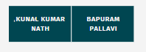
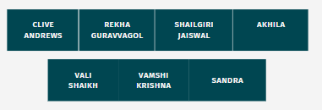
MENTORS
OUR TEAM

Slide 3
KPI1
KPI2
KPI3
Agenda
KPI4
KPI5
DASHBOARD
REVIEW
Challenges

Slide 4
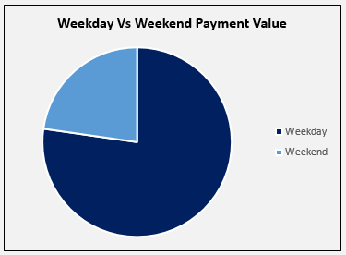
KPI1
Weekday Vs Weekend Payment Statistics
23%
Weekday sales are higher
To improve sales on weekend
>Keep offers on weekends
>Provide the vouchers
77%

Slide 5
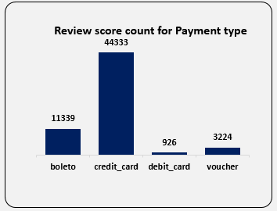
KPI2
Review Score 5, total count for different Payment type
Credit card score is higher
Credit card offers many advantages
Limit the instalments duration to avail the maximum sale
Keep special offers for using Boleto in physical stores on weekends

Slide 6
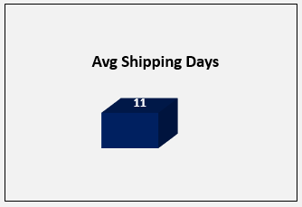
KPI3
Average number of days taken for Pet Shop Product
Overall Average Delivery days are 12
Shipping days vary from 1-76 days
Target to reduce the shipping days
>Segregate the top moving products
>Prioritize the products according to
the customer history
PET SHOP

Slide 7
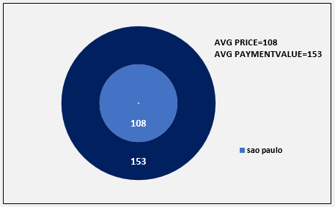
KPI4
Average Price and Payment value for Sao Paulo City
Overall Product, Average Price->120.82 and Payment value->172.69
Sao Paulo city customers buy low price products
To achieve highest sale
>Top products stocked adequately
>Offer as buy1-get1 for more sale
>Reviews from the seller

Slide 8
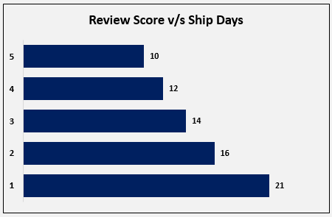
KPI5
Relationship between Shipping days and Review Score
Customers will be happy if the product delivered faster
Keep customers happy (Customer loyalty program)
>Providing membership (Ex: Gold)
>We can avail free shipment charges
>Providing Vouchers
>Discounts after reaching target
>Gift products

Slide 9
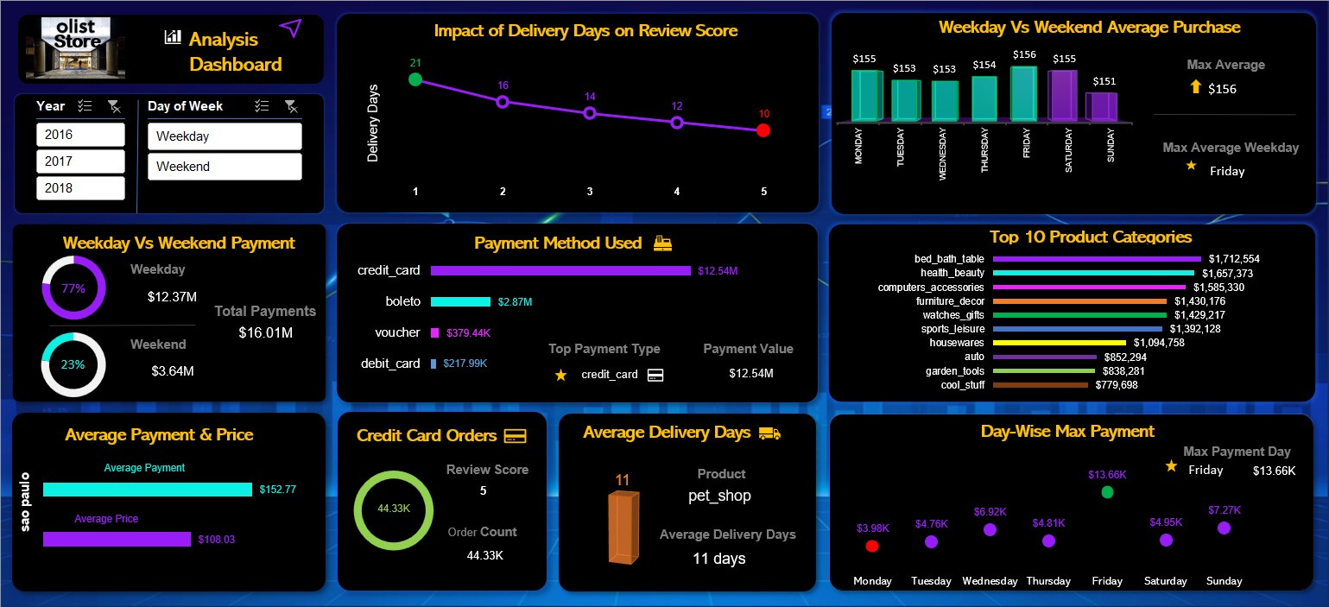
EXCEL DASHBOARDE

Slide 10
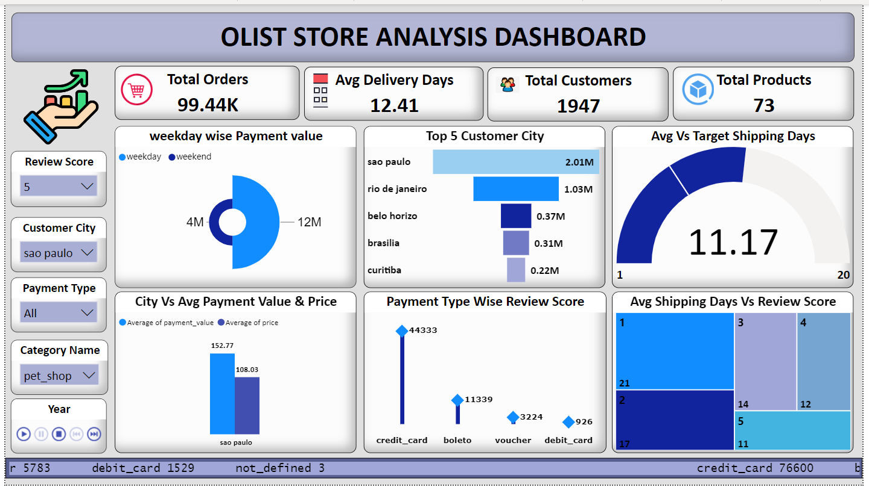
POWERBI DASHBOARD
https://app.powerbi.com/groups/me/reports/acb6de6f-4782-4e19-8842-20bc7dcd0b5b/ReportSection33b73017904197ac950e?experience=power-bi

Slide 11
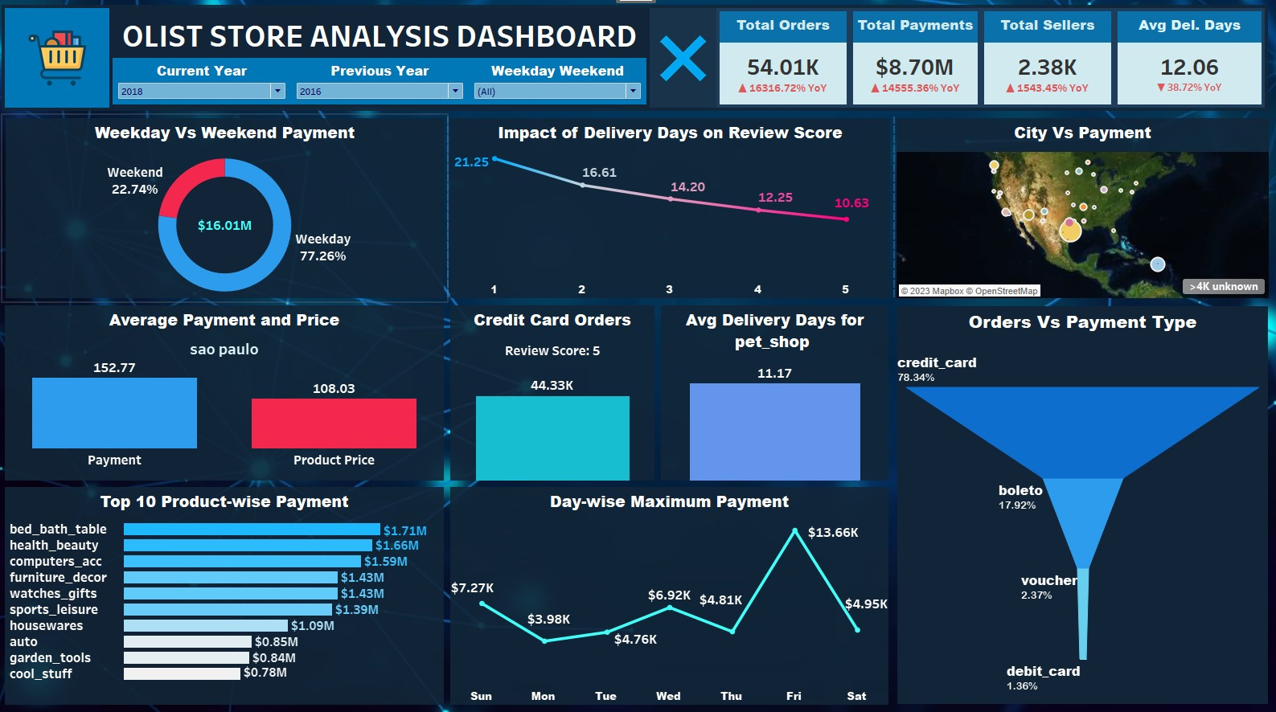
TABLEAU DASHBOARD
https://public.tableau.com/views/OLISTSTOREDASHBOARD/MainDashboard?:language=en-US&publish=yes&:display_count=n&:origin=viz_share_link

Slide 12
Review
Throughout this project, we learnt on-How to,
> Import Data
> Clean Data
> Creating relationship and Analysing with
different tools
> Visualization
Showcasing the same KPI's on different tools
Working within team, helping and motivating
each other

Slide 13
Challenges
CHALLENGES FACED DURING THE PROJECT
Merging files in Excel, leads to decrease number
of rows
Consolidated table gives the variation in the KPIs
Loading large CSV files to MySQL takes time up to 15-45minutes
Faced difficulty while Importing MySQL database to Powerbi

Slide 14
THANK YOU

